Slide 1

LITERATURE REVIEW
RESEARCH METHODOLOGY AND SCIENTIFIC WRITING
FACULTY OF COMPUTER SCIENCE, UNIVERSITAS INDONESIA

Slide 2




Session Objectives
To understand the purpose of literature review
To understand how to search relevant literatures.
To understand the components of literature to be reviewed.
To understand what plagiarism is and how to avoid them

Slide 3


Learning Outcomes
Students should be able to conduct literature review
Students should be able to avoid plagiarism in writing academic papers

Slide 4
Review of Previous Sessions: Research Understanding
Research is: “…the systematic process of collecting and analyzing information (data) in order to increase our understanding of the phenomenon about which we are concerned or interested.”
A research cannot stand on its own; it is built from other previous research. In order to construct previous research, we need to review previous research’s findings.
Hence, the importance of conducting literature review.

Slide 5
What is a Literature Review? (Source: University Library, University of California)
It is a surveys of scholarly articles, books and other sources (e.g. dissertations, journal, conference proceedings) relevant to a particular issue, area of research, or theory.
Textbook, magazines, bulletin, etc. are NOT suggested!
It is providing a description, summary, and critical evaluation of each work (each research article).
The purpose is to offer an overview of significant literatures published on a topic (overview the state-of-the-art).

Slide 6
Why Doing a Literature Review?
To identify gaps in the literature.
To avoid “reinventing the wheel”.
To identify relevant methods to your project.
To build on the platform of existing knowledge and ideas.
To identify other people working in the same fields 🡪 networking!
To increase your breadth of knowledge of your subject area.
To identify similar works in your area, OR even identifying opposing views.

Slide 7
Where to Place Your Literature Review?
Usually it’s placed at Chapter 2 of your thesis or dissertation.
A literature review may constitute an essential chapter of a thesis or dissertation.
Literature review should logically connected to research problems, research methodology, analysis and conclusion.
Beside that, from reviewing literatures, you can write a review paper.

Slide 8
Stages of Literature Reviews (Source: University Library, University of California)
Problem Formulation
Which topic or field is being examined and what are the issues?
Literature Search
Finding materials relevant to the subject being explored 🡪 more on this on the next slide!
Data Evaluation
Determining which literature makes a significant contribution to the understanding of the topic.
Analysis and Interpretation
Discussing the findings and conclusions of pertinent literature.

Slide 9
How to Find Relevant Literatures
Search with the key words of the research topic.
Use broader key words (term) if the documents retrieved are few or none.
Use narrower key words if the documents retrieved are too much (consult thesaurus).
Use synonym or related terms to enhance the search.
Searching is part of science in Information Retrieval.

Slide 10
Algorithm to Find Related Literatures
Determine the research topic.
Pick the most recent article related to that topic.
Read the article thoroughly.
Take a note on important problems, issues, techniques, analysis, findings, and conclusions.
Start look for another related articles through:
New search terms (key words) found in the related articles
List of references in the chosen article
Form a body of literatures relevant to the topic.
Span of time (from older time to the recent time)
Span of topic (one topic may relate to another topic)

Slide 11
Techniques to Review Literatures
Compare: try to find the similarities among literatures
🡪 Explain how each article similar to the others.
Contrast: try to find the differences among literatures
🡪 Explain how each article differ to the others
Criticize: put your own opinion on what is written in the literatures. Do not hesitate to write your opinion!!!
🡪 Criticize the strength and weakness of the research
Synthesize: combine several literatures into an idea
Summarize: restate the article with your own words in a concise way

Slide 12
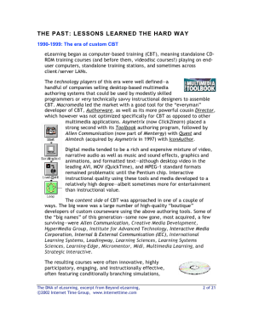
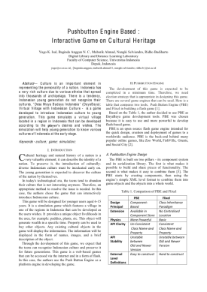
Examples: Comparing
“Menurut penelitian yang dilakukan oleh Andri (1999), kinerja IRS dengan menggunakan teknik Extended Boolean lebih baik dibanding menggunakan teknik Boolean saja. Hal ini sejalan dengan hasil-hasil penelitian sebelumnya yang dilakukan oleh Savoy (1995), Salton (1990), dll.”
Andri, 1999
Si penulis melakukan komparasi (comparing) paper Andri, Savoy dan Salton (mencari yg sama)
Savoy, 1995
Salton, 1990

Slide 13
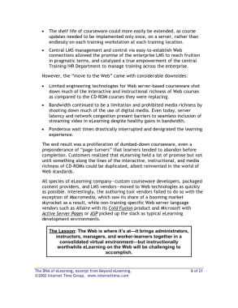
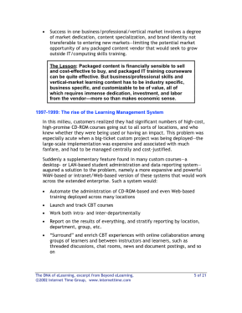
Examples: Contrasting
“Hasil penelitian yang dilakukan oleh Santoso (2006) menunjukkan bahwa gaya belajar konstruktif lebih adaptif terhadap penggunaan ICT. Hal ini bertentangan dengan hasil penelitian lainnya yang mengatakan bahwa gaya positivis yang lebih adaptif terhadap penggunaan ICT (Ford, 1998; Huge, 2001”).
Santoso, 2006
Si penulis mencari kontras (contrasting)
paper dari Santoso, dengan Ford
dan Huge (mencari perbedaannya)
Ford, 1998
Huge, 2001

Slide 14
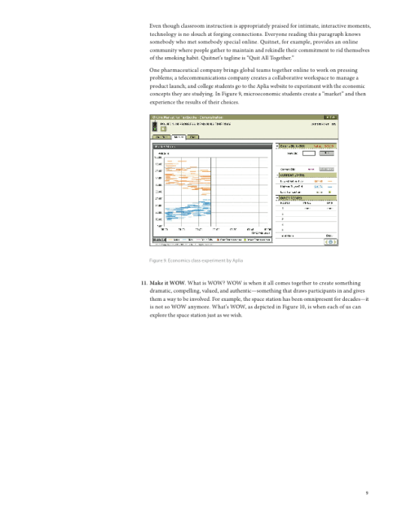
Examples: Criticize
“Menurut Hadi (2005) Sistem Informasi Untuk Eksekutif (EIS) dapat membantu pimpinan mengambil keputusan lebih akurat sekitar 90% dibanding tidak menggunakan EIS, tetapi tidak dijelaskan berapa banyak sampel EIS yang disurvei dan kategori keputusan yang bagaimana yang dijadikan sebagai acuan.”
Si penulis mengkritik
paper Hadi,
(mencari kelemahan)
Hadi, 2005

Slide 15
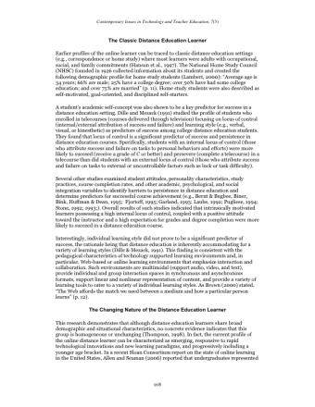
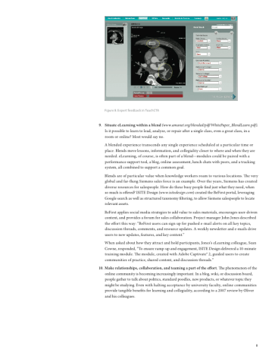
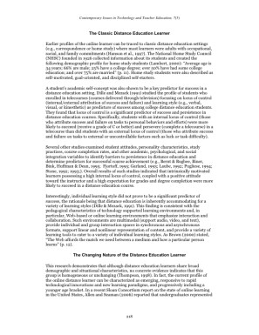
Examples: Synthesize
“Menurut Hadi (2005) keberhasilan suatu Sistem Informasi Untuk Eksekutif (EIS) sangat ditentukan oleh tingkat keakuratan menangkap kebutuhan para eksekutif; sedangkan menurut Amir (2006), EIS sangat ditentukan oleh kejelasan core business dari perusahaannya. Dari kedua pendapat tersebut, dapat dikatakan bahwa faktor-2 penentu keberhasilan EIS antara lain: keakuratan menangkap kebutuhan pimpinan, dan kejelasan core bisnis perusahaan”
Synthesize:
combine several literatures into an idea
Hadi, 2005
Amir, 2006

Slide 16
PLAGIARISM, CODE OF ETHICS & CITATION
RESEARCH METHODOLOGY AND SCIENTIFIC WRITING
FACULTY OF COMPUTER SCIENCE, UNIVERSITAS INDONESIA

Slide 17
What is Plagiarism?
Definition based on Merriam-Webster Online Dictionary:
- To steal and pass off (the ideas or words of another) as one’s own
- To use (another’s production) without crediting the source
- To commit literary theft
- To present as new and original an idea or product derived from an existing source
Fraud (stealing others’ work + lying about it)
Violates copyright laws
Not tolerated in academic environment

Slide 18
Plagiarism Spectrum
Proposed by Turnitin, web-based solution for plagiarism prevention, in 2012
Defined 10 types of unoriginal work and ranked it by frequency, problematic, and severity
From most severe to least severe:
- Clone
- Ctrl-C
- Find-Replace
- Remix
- Recycle
- Hybrid
- Mashup
- 404 Error
- Aggregator
- Re-Tweet

Slide 19
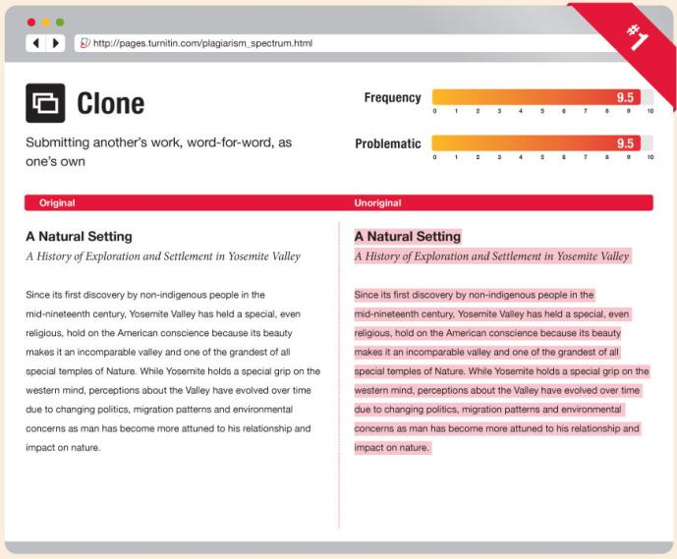
Clone
An act of submitting another’s work, word-for-word, as one’s own

Slide 20
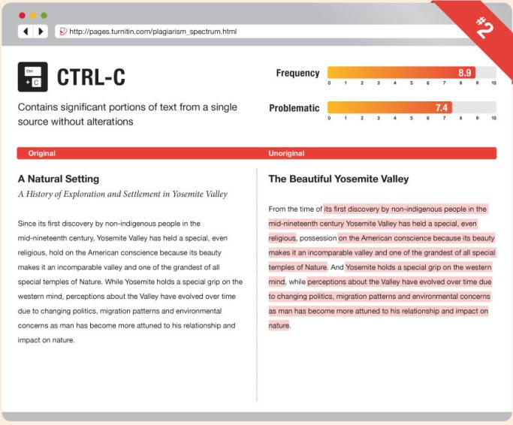
Ctrl-C
A written piece that contains significant portions of text from a single source without alterations

Slide 21
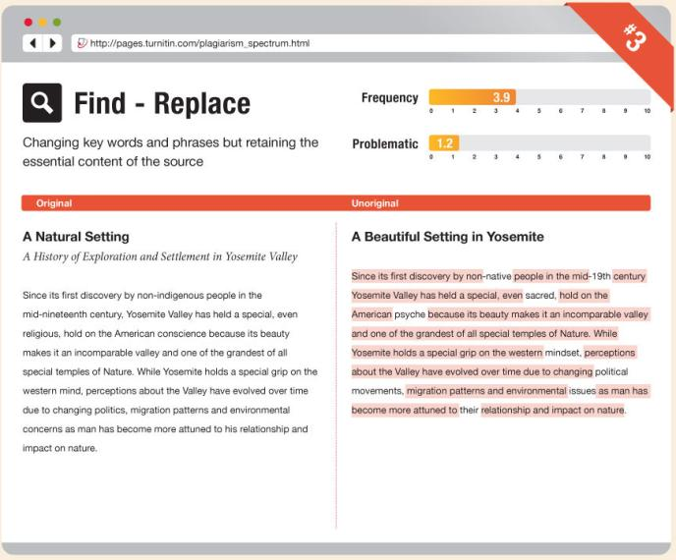
Find-Replace
Act of changing key words and phrases but retaining the essential content of he source in a paper

Slide 22
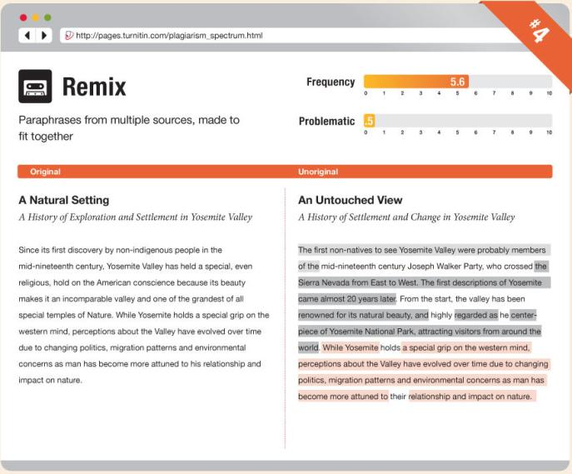
Remix
Act of paraphrasing from other sources and making the content fit together seamlessly

Slide 23
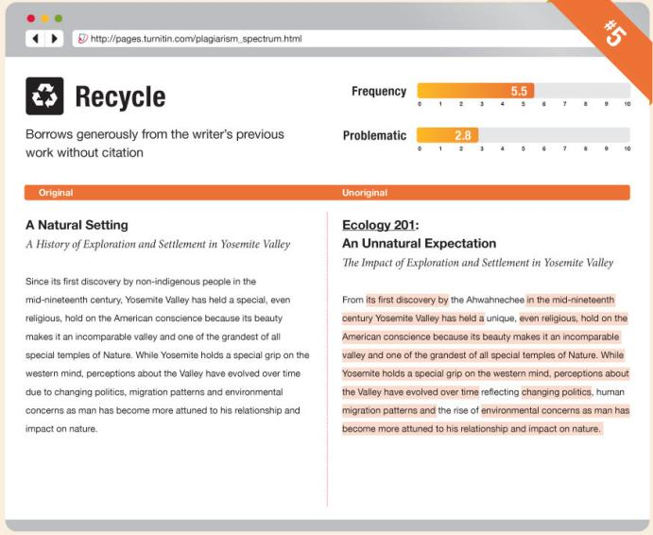
Recycle
Act of borrowing generously from one’s own previous work without citation; also known as self-plagiarism

Slide 24
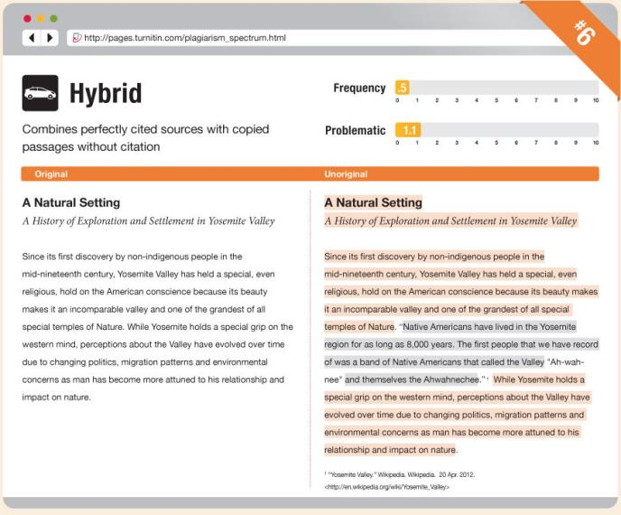
Hybrid
Act of combining perfectly cited sources with copied passages, which are without citation, in one paper

Slide 25
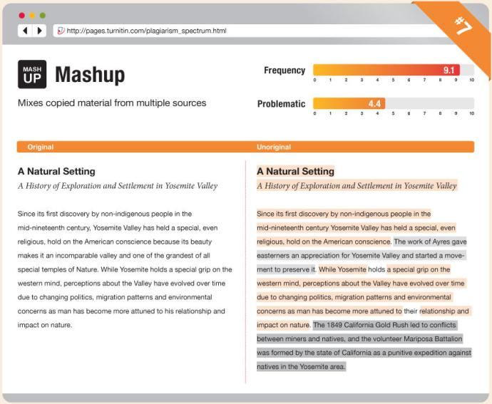
Mashup
Paper that represents a mix of copied material from several different sources without proper citation

Slide 26
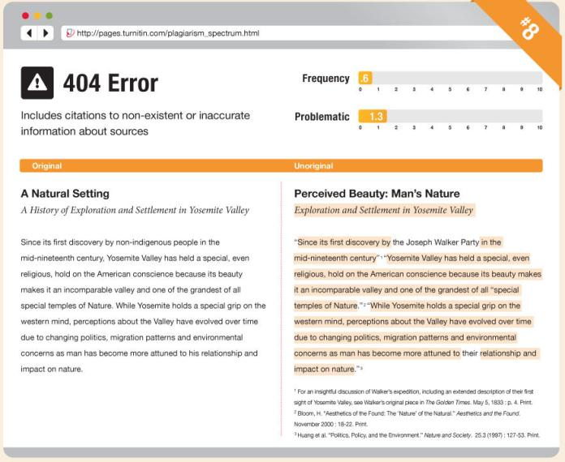
404 Error
A written piece that includes citations to non-existent or inaccurate information about sources

Slide 27
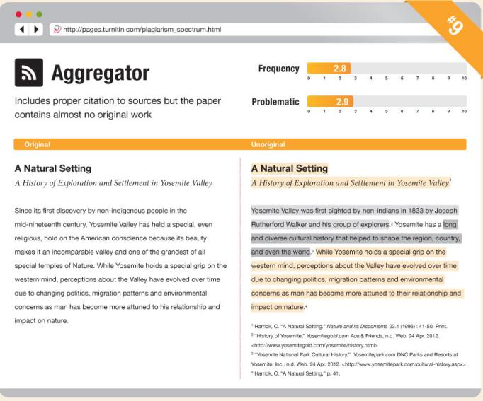
Aggregator
A paper which includes proper citation but contains almost no original work

Slide 28
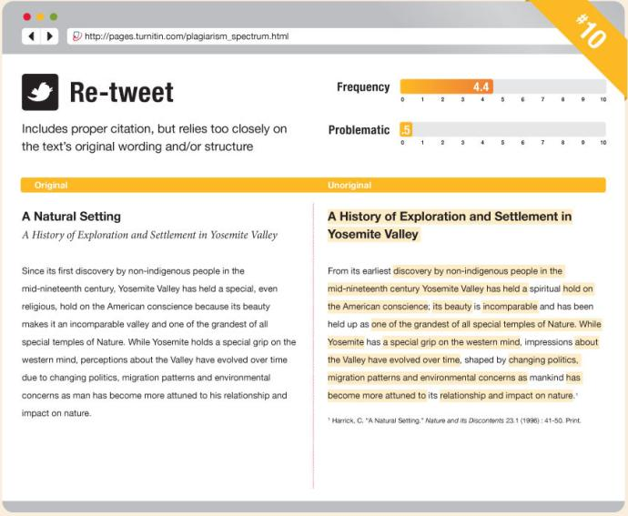
Re-tweet
A paper which includes proper citation, but relies too closely on the text’s original wording and/or structure

Slide 29
How to Avoid Plagiarism?
During Planning
During Writing
Consult with instructor
Plan the paper
Take effective notes
When in doubt, cite sources
Make it clear who said what
Know how to paraphrase
Analyze and evaluate sources

Slide 30
Will Citing Weakens My Paper?
You may think that citing weakens paper, making it seems there are less original ideas
Citing actually strengthen by:
Showing that you are not just copying other ideas but are processing and adding to them
Lending outside support to the ideas that are completely yours
Highlighting the originality of your ideas by making clear distinctions between them and ideas you have gotten elsewhere

Slide 31
THANK YOU Any Questions?

